Slide 1

CSE 473
Pattern Recognition

Slide 2
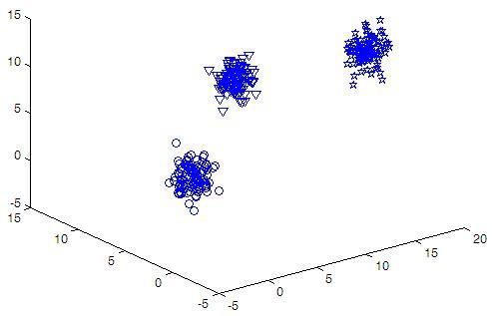
Sample Data for Sessional on
Bayesian Classification (Week2)

Slide 3
3 3 300
Feature1 Feature2 Feature3 Class
11.0306 9.0152 8.0199 1
11.4008 8.7768 6.7652 1
11.2489 9.5744 8.0812 1
9.3157 7.4360 5.6128 1
15.7777 1.5879 11.4440 2
15.8685 2.7902 11.2532 2
14.9448 0.7798 12.7481 2
15.9801 1.0142 14.2029 2
2.3979 5.6525 2.7566 3
2.5103 6.3484 1.4272 3
1.3739 3.2679 1.2037 3
2.7527 4.6571 3.1138 3
-0.0195 4.5524 0.0118 3
Sample Data
for
Bayesian
Classification

Slide 4
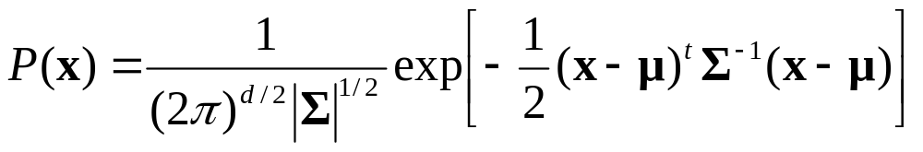
Assumption on Data Distribution
Assume multivariate density
  Multivariate normal density in d dimensions is:
where:
x = (x₁, x₂, …, x_{d})^{t} (t stands for the transpose vector form)
μ = (μ₁, μ₂, …, μ_{d})^{t} mean vector
Σ = d*d covariance matrix
|Σ| and Σ⁻¹ are determinant and inverse respectively

Slide 5
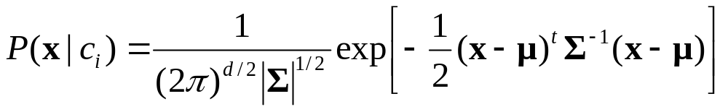
Algorithmic Steps
No. of features and classes will be variable
Use library functions to find μ, Σ , |Σ| and Σ⁻¹ from training data for each class
For a test sample x, find p(c_{i}|x) or p(c_{i})×p(x|c_{i}) for each class c_{i} where
Use different data files during evaluation

Slide 6
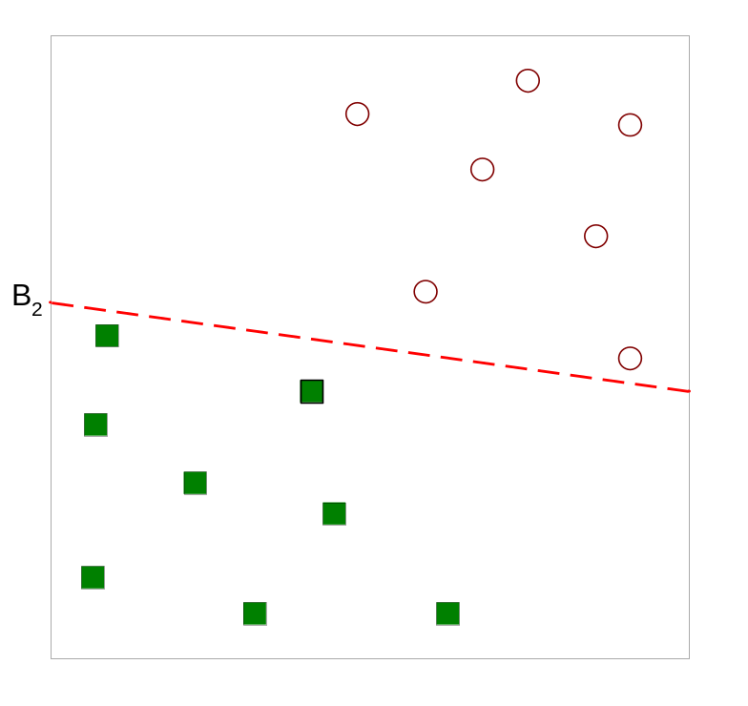
Linear Classifier: Introduction
Classifies linearly separable patterns
Assume proper forms for the discriminant functions
may not be optimal
very simple to use

Slide 7
Linear discriminant functions and decisions surfaces
Definition
  Let a pattern vector x = {x₁, x₂, x₃, …,}
  a weight vector w = {w₁, w₂, w₃, …,}
  A discriminant function :
  g(x)=x₁w₁+x₂w₂+x₃w₃+…
  OR
  g(x) = w^{t}x + w₀
  where w is the weight vector and w₀ the bias

Slide 8
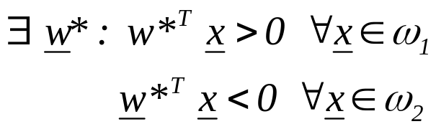
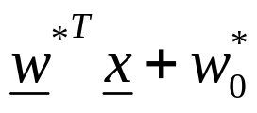
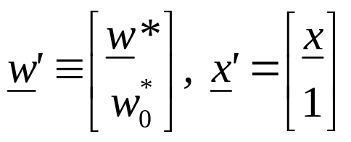
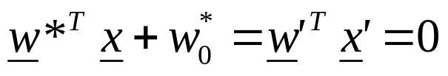
The Perceptron Algorithm
  Assume linearly separable classes, i.e.,
  The case
  falls under the above formulation, since

Slide 9
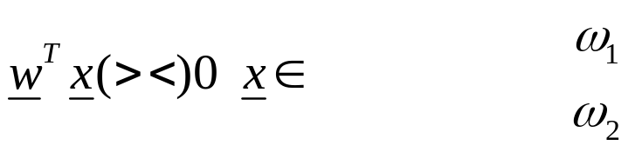
  Our goal: Compute a solution, i.e., a hyperplane w,
  so that
    The steps
      Define a cost function to be minimized
      Choose an algorithm to minimize the cost function
      The minimum corresponds to a solution

Slide 10
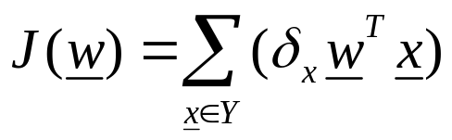
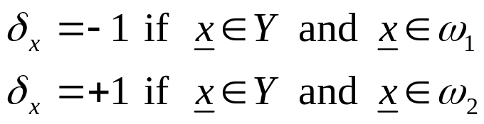
  The Cost Function
    Where Y is the subset of the vectors wrongly classified by w.

Slide 11
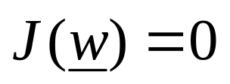
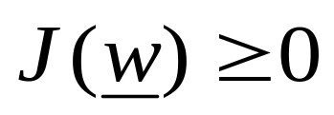
  The Cost Function
    Where Y is the subset of the vectors wrongly classified by w.
    when Y=(empty set) a solution is achieved and
    otherwise

Slide 12

    J(w) is piecewise linear (WHY?)
  The Algorithm
    The philosophy of the gradient descent is adopted.

Slide 13
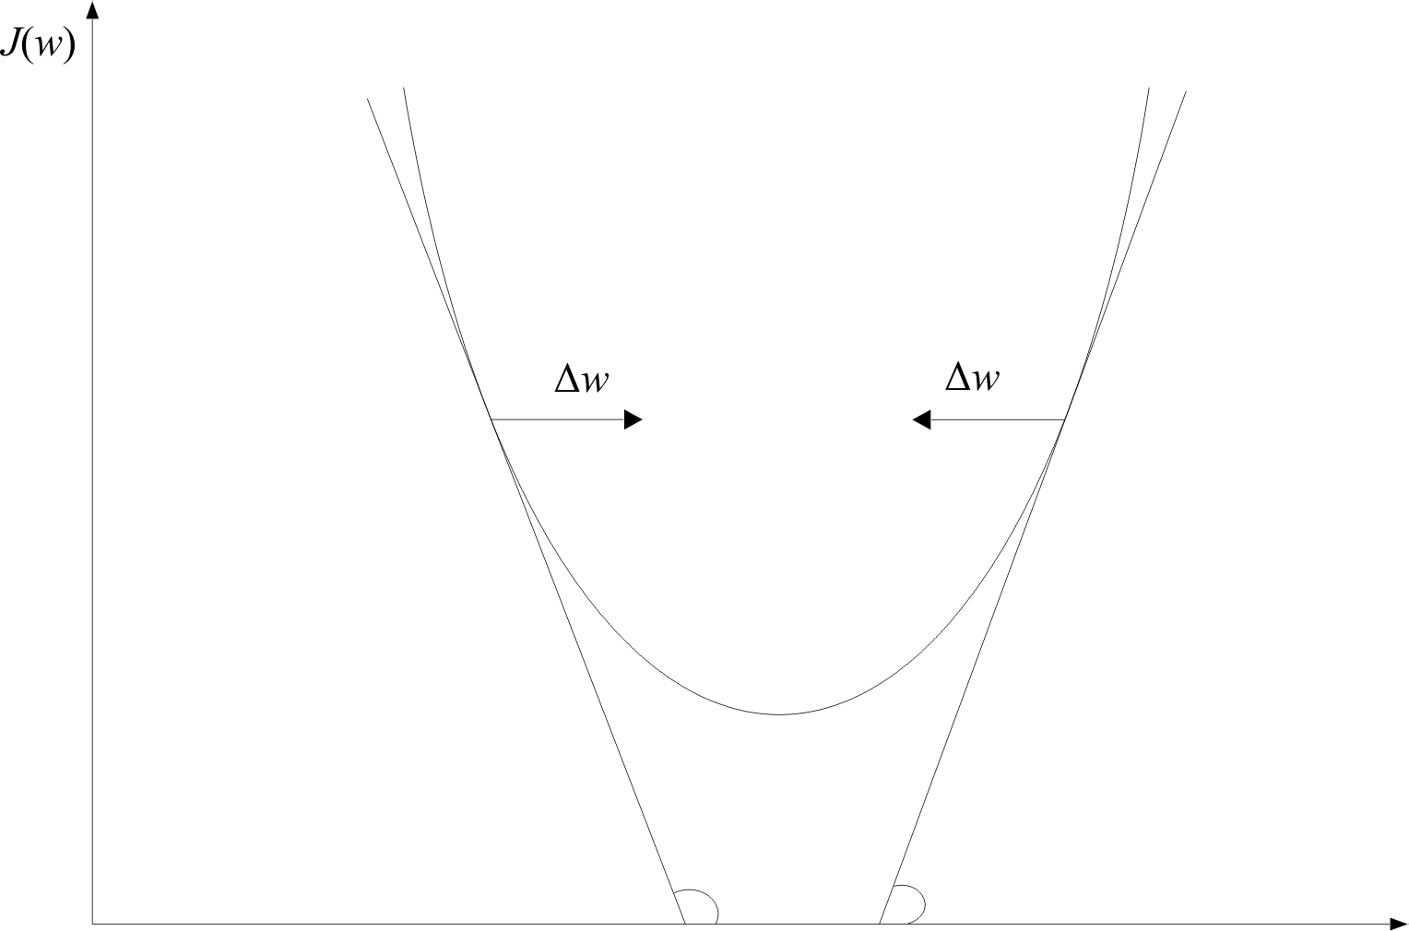
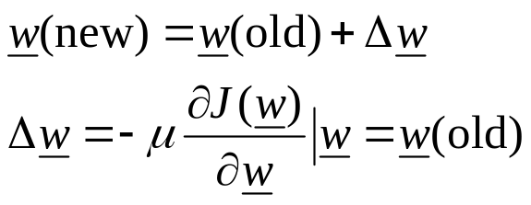
w

Slide 14
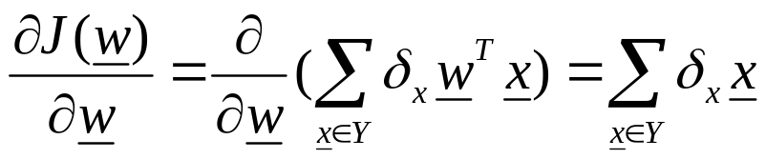
    Wherever valid
w

Slide 15
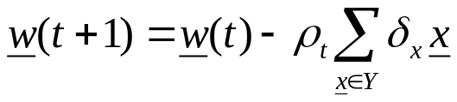
    Wherever valid
w

Slide 16
    Wherever valid
    This is the celebrated Perceptron Algorithm
w

Slide 17
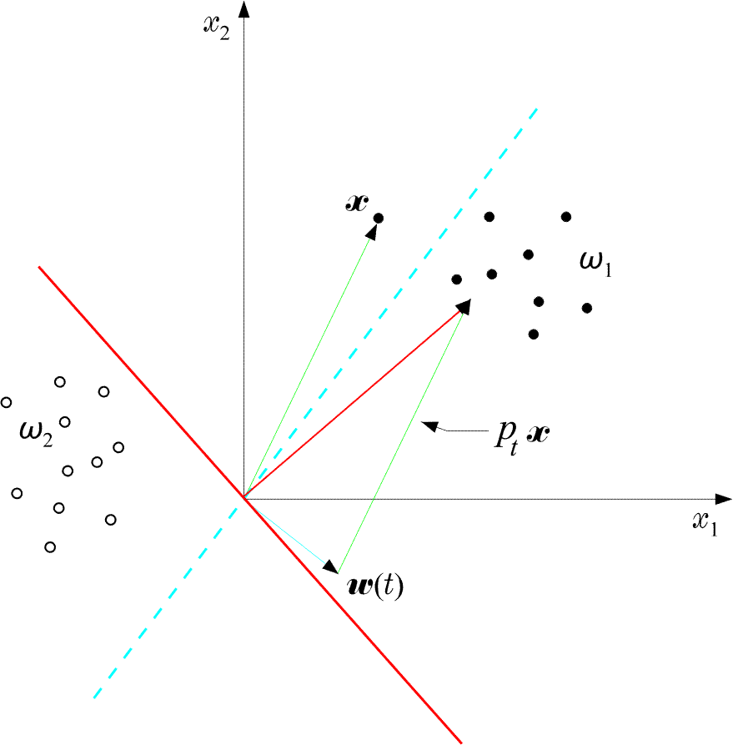
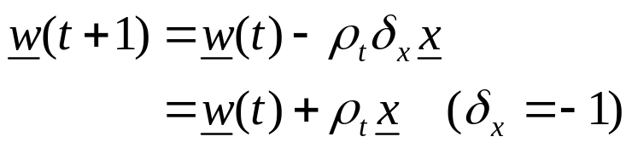
  An example:

Slide 18
  An example:
  The perceptron algorithm converges in a finite number of iteration steps to a solution if patterns are linearly separable

Slide 19

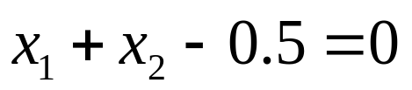
  Example: At some stage t the perceptron algorithm results in

Slide 20
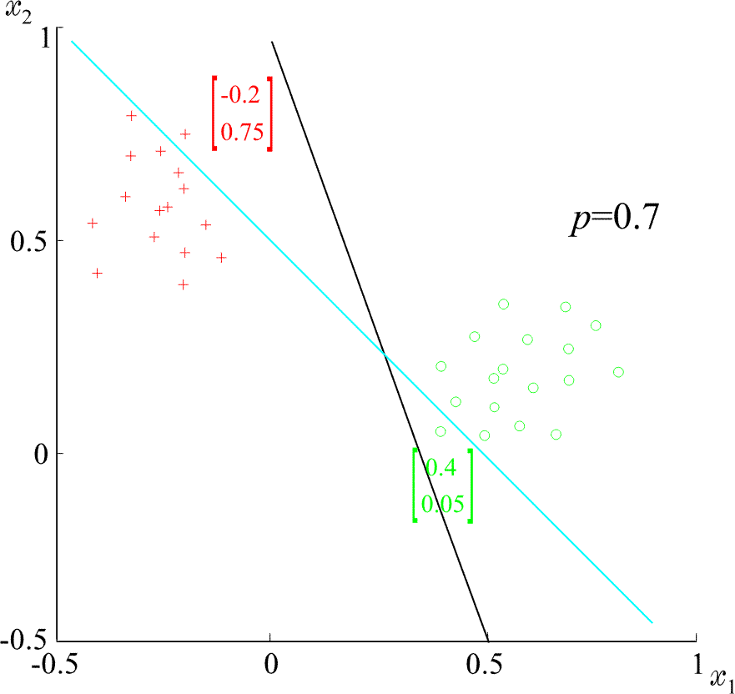
  Example: At some stage t the perceptron algorithm results in
  The corresponding hyperplane is
+
+
+
+
ρ=0.7
+
+
+

Slide 21
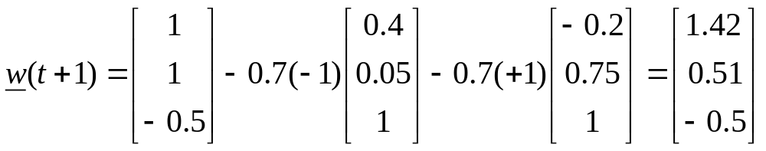
  Example: At some stage t the perceptron algorithm results in
  The corresponding hyperplane is
+
+
+
+
ρ=0.7
+
+
+

Slide 22
  Example: At some stage t the perceptron algorithm results in
  The corresponding hyperplane is
+
+
+
+
ρ=0.7
+
+
+

Slide 23
Convergence Proof of Perceptron Algorithm
Let , w* be the optimal weight vector
w(t) be the weight vector at the tth iteration
w(t+1) be the weight vector at the (t+1)th iteration

Slide 24
Convergence Proof of Perceptron Algorithm
Let , w* be the optimal weight vector
w(t) be the weight vector at the tth iteration
w(t+1) be the weight vector at the (t+1)th iteration
We will prove that ||w(t+1) - w* || < ||w(t) - w* ||

Slide 25

Convergence Proof of Perceptron Algorithm
We know that
Let , α be a positive real number
Then,

Slide 26


Convergence Proof of Perceptron Algorithm
Squaring both sides,

Slide 27

Convergence Proof of Perceptron Algorithm
However,

Slide 28


Convergence Proof of Perceptron Algorithm
However,
Hence,

Slide 29


Convergence Proof of Perceptron Algorithm
Now, define
and

Slide 30

Convergence Proof of Perceptron Algorithm
Now, define
and
Here, is always negative, so is γ

Slide 31

Convergence Proof of Perceptron Algorithm
Now, define
and
Here, is always negative, so is γ
We can write,

Slide 32

Convergence Proof of Perceptron Algorithm
If we choose,
We can write,

Slide 33
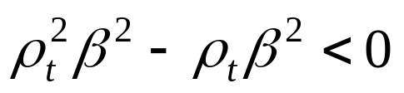
Convergence Proof of Perceptron Algorithm
Here,
How?

Slide 34

Convergence Proof of Perceptron Algorithm
Applying the above equation successively for steps t, t-1, . . ., 0, we get

Slide 35


Convergence Proof of Perceptron Algorithm
Applying the above equation successively for steps t, t-1, . . ., 0, we get
However,
and

Slide 36
Convergence Proof of Perceptron Algorithm
However,
and
This means,
After some constant tine t₀ the R. H. S. will be non-positive
But, the L. H. S. cannot be negative
Therefore,

Slide 37

Convergence Proof of Perceptron Algorithm
is equivalent to

Slide 38
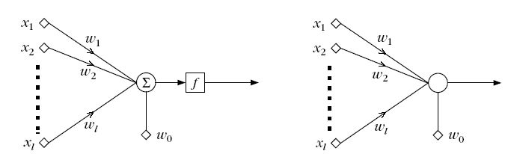
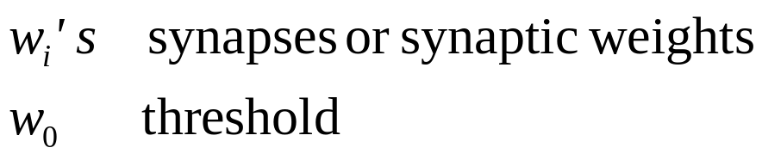
The Perceptron
This structure is called perceptron or neuron
a learning machine that learns from the training vectors

Slide 39
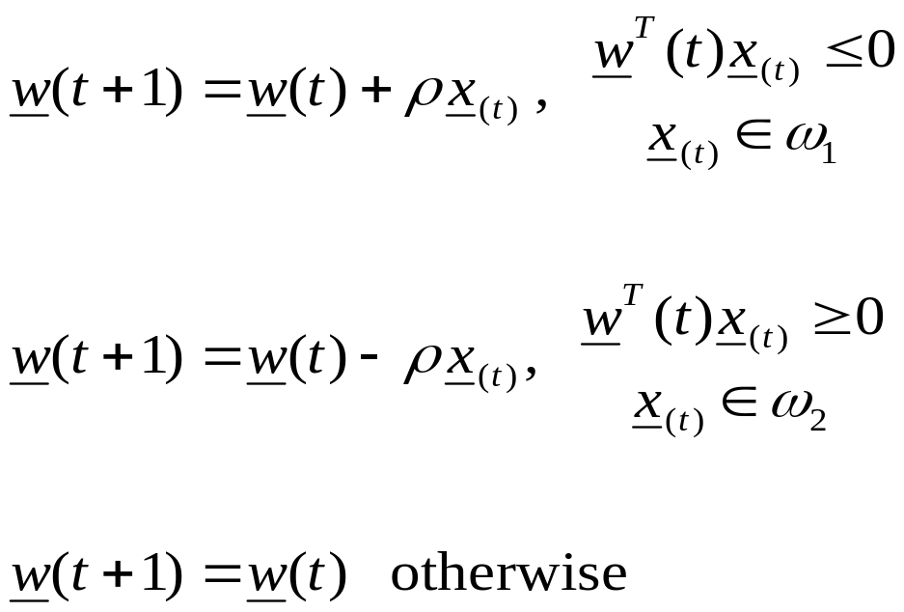
Variants of Perceptron Algorithm (1)

Slide 40

Variants of Perceptron Algorithm (1)
No Update

Slide 41
Variants of Perceptron Algorithm (1)
  It is a reward and punishment type of algorithm
No Update

Slide 42
Variants of Perceptron Algorithm (2)
initialize weight vector w(0)
define pocket w_{s}.and history h_{s}
generate next w(t+1). If it is better than w(t), store w(t+1) in w_{s} and change the h_{s}

Slide 43
Variants of Perceptron Algorithm (2)
initialize weight vector w(0)
define pocket w_{s}.and history h_{s}
generate next w(t+1). If it is better than w(t), store w(t+1) in w_{s} and change the h_{s}
  It is pocket algorithm

Slide 44
Generalization of Perceptron Algorithm for M- Class case

Slide 45
Generalization of Perceptron Algorithm for M- Class case
Let M classes ω_{1,} ω_{2,} ω_{3,} . . ., ω_{M,}
Let M linear discriminant functions, w_{i}

Slide 46

Generalization of Perceptron Algorithm for M- Class case
Let M classes ω_{1,} ω_{2,} ω_{3,} . . ., ω_{M,}
Let M linear discriminant functions, w_{i}
The object x is classified to ω_{i}, if

Slide 47
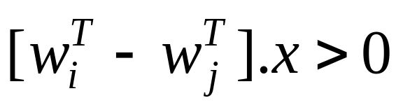
Generalization of Perceptron Algorithm for M- Class case
The object x is classified to ω_{i}, if

Slide 48
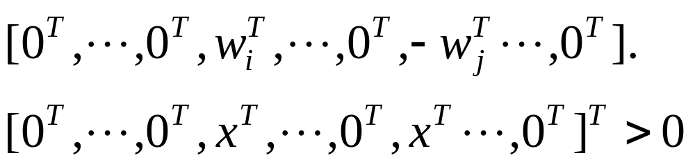
Generalization of Perceptron Algorithm for M- Class case
The object x is classified to ω_{i}, if
can be written as

Slide 49
Generalization of Perceptron Algorithm for M- Class case

Slide 50
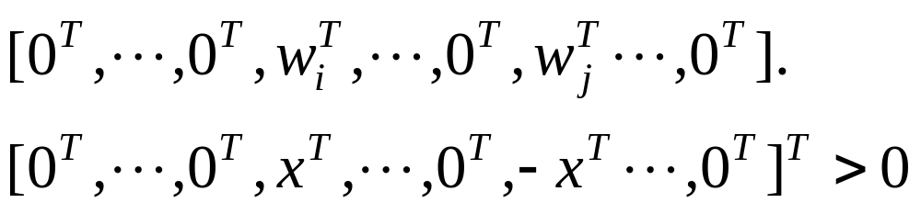
Generalization of Perceptron Algorithm for M- Class case

Slide 51
Generalization of Perceptron Algorithm for M- Class case

Slide 52
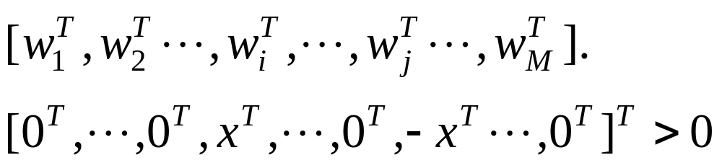
Generalization of Perceptron Algorithm for M- Class case

Slide 53
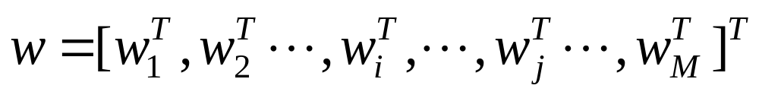
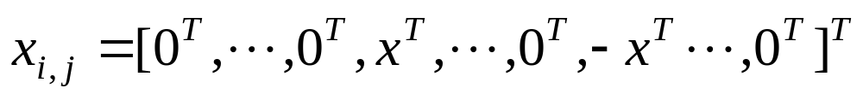
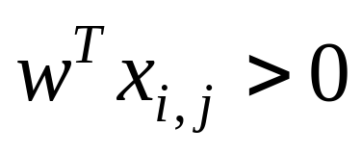
Generalization of Perceptron Algorithm for M- Class case
Let,
and
Then, the condition is

Slide 54
Generalization of Perceptron Algorithm for M- Class case
For each training vector of class ω_{i}, construct
ith location
jth location
(l+1)M dimension
Concatenate the weight vectors:

Slide 55
Generalization of Perceptron Algorithm for M- Class case
Use a single Perceptron to solve
Parameters:
  (l+1)M feature dimension
  All N(M-1) training vectors to be on positive side
This reorganization is known as Kesler’s construction

